Slide 1

Mental Health Treatment Prediction
Group 6
Richard Desmond Darren Kurtis

Slide 2

Content
Goals of Our Research (Business Question of Our Project)
Preprocessing
Model Selection
Model Evaluation
Conclusion and Future Improvement

Slide 3

01
Background and Goal

Slide 4
Goal
To see if we can use machine learning to predict whether or not the participant attended treatment

Slide 5
Business Values for Companies
Identify the needs for mental health resources
Re-evaluate the health insurance coverage
Satisfaction assessment criteria among Employees
Develop a more effective diagnosis protocol

Slide 6

Dataset:
Mental Health in Tech Survey
Dataset from a 2014 survey that measures respondents’ attitudes towards mental health and frequency of mental health disorders in the tech workplace.
27 variables/columns included (but not limited to):
Respondent’s age, gender, country
Respondents/families treatment history
Respondent’s view towards mental health support in their workplace

Slide 7
Assumptions & Hypothesis
Age
Family History
Male & LGBTQ
18-54, average age at onset is the mid-20s
2-6x risk than those without
4-6x higher in mental disorders & suicidal rate
Resource Availability
Self-employed
Lack of mental health support
Higher risk of having mental illness
References:
https://www.hopkinsmedicine.org/health/wellness-and-prevention/mental-health-disorder-statistics
https://www.ncbi.nlm.nih.gov/pmc/articles/PMC6761480/
https://www.cdc.gov/workplacehealthpromotion/tools-resources/pdfs/issue-brief-no-2-mental-health-and-chronic-disease.pdf

Slide 8

02
EDA & Preprocessing

Slide 9
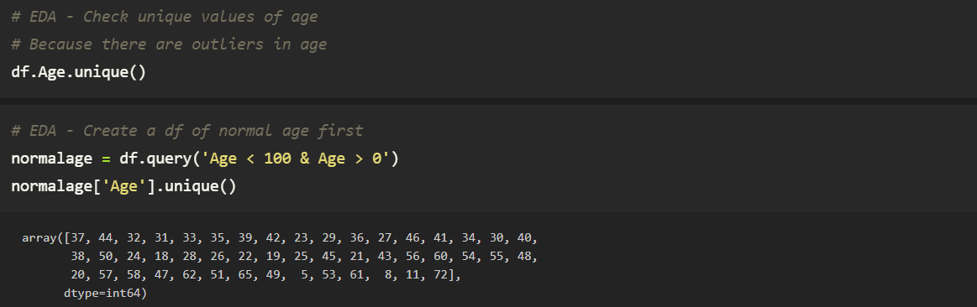
Outlier Handling

Slide 10
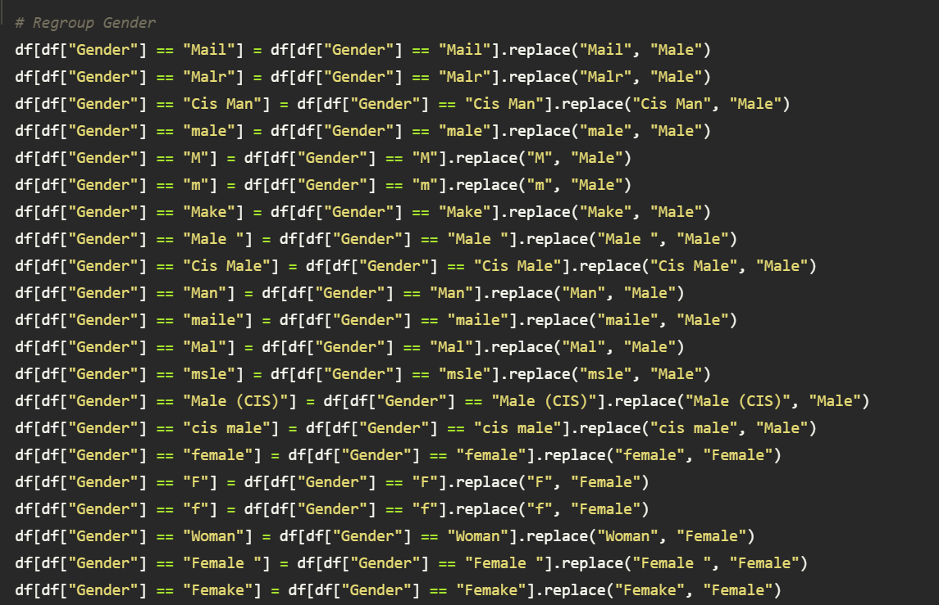
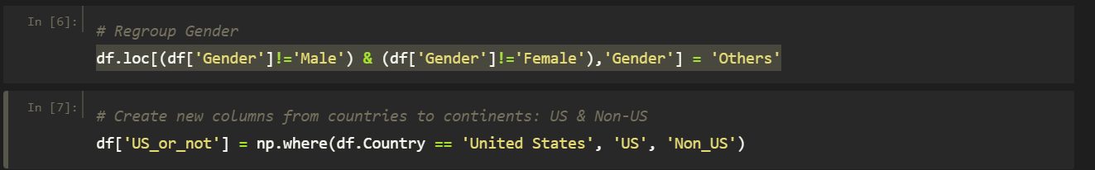
Data Cleaning

Slide 11
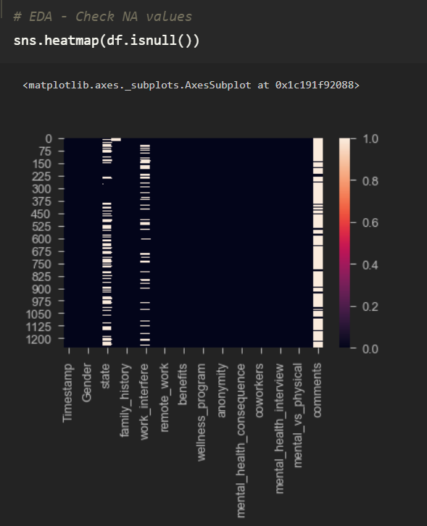
Missing Values

Slide 12
03
Model Selection

Slide 13

Selecting the Target Feature and Features
Target Feature
Treatment
“Have you sought treatment for a mental health condition?”
Features
Age, gender, country
Family history
View towards mental health support in their workplace

Slide 14

Modeling
Classification
01
02
03
04
kNN
Logistic Regression
Random Forest
XGBoost

Slide 15
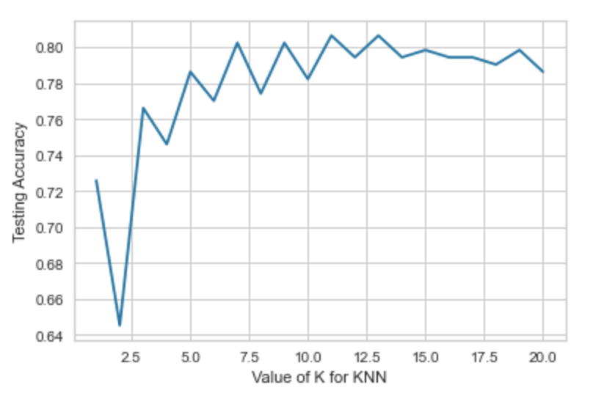
01 kNN
Creating model with KNeighborsClassifier in a range of 1 to 20
Range of K value with high accuracy
K value = 13
Accuracy = 0.8064

Slide 16
01 kNN
Hyperparameter Tuning
GridSearchCV: grid = GridSearchCV(knn, param_grid=params, cv=10)
Best_params = {'n_neighbors': 15}
Best_score = 0.8128942486085343
Cross-validation: knn = KNeighborsClassifier(n_neighbors=15) & cv=10
scores.mean() = 0.8128942486085343
Accuracy 1% after tuning

Slide 17
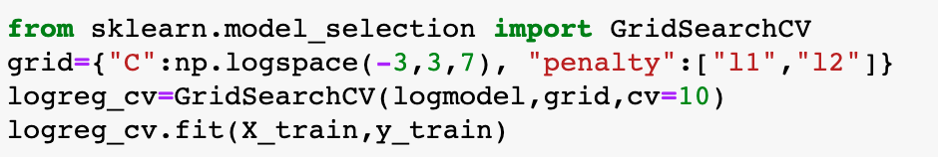
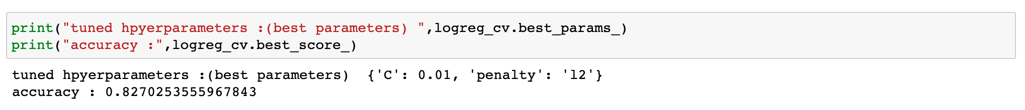
02 Logistic Regression

Slide 18
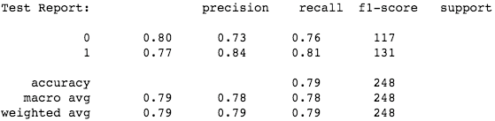
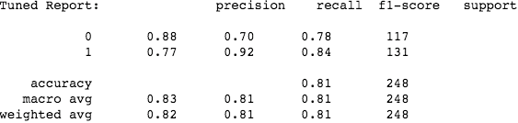
03 Random Forest
Model Building
Build the RF with default parameters
RandomizedSearchCV to obtain performing parameters in brief,
i.e. n_estimators, max_depth, max_features
Hyperparameter Tuning
GridSearchCV to refine and narrow down for best parameters,
i.e. min_samples_split, min_samples_leaf, criterion, bootstrap + above params
3%
higher

Slide 19
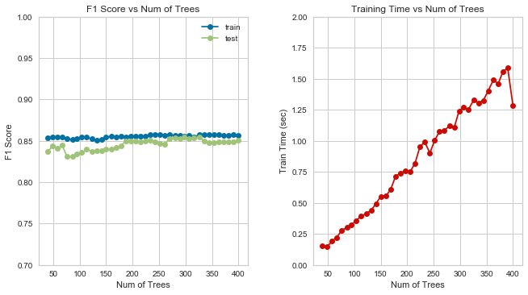
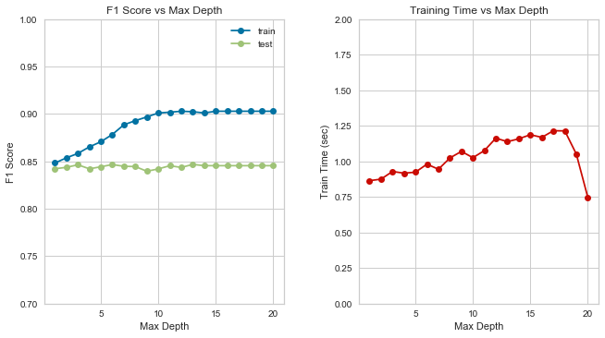
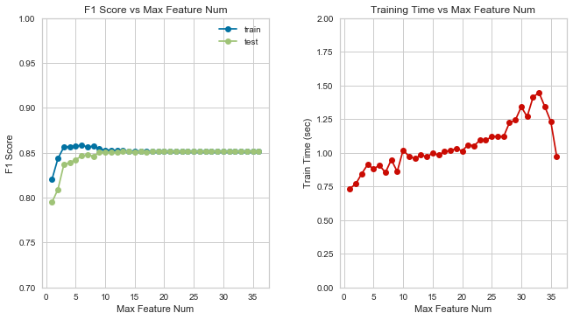
03 Random Forest
Optimal points of three most paramount parameters - Num of trees, Max Depth, Max Features

Slide 20
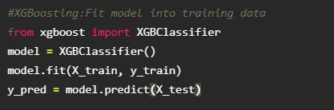
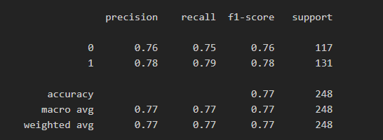
04 XGBoost
Model Building- with Default Parameters

Slide 21
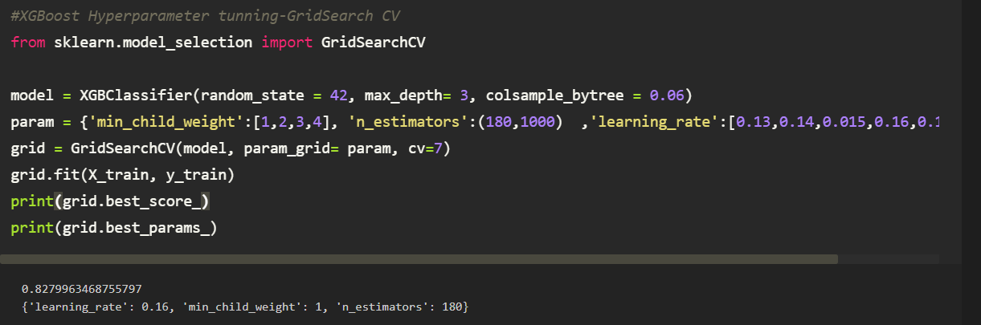
04 XGBoost
Hyperparameter Tuning

Slide 22
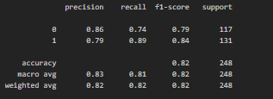
04 XGBoost
Hyperparameter Tuning
5%
higher

Slide 23

04
Model Evaluation

Slide 24
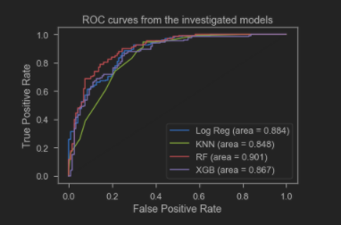
Model Comparison: with ROC Curves

Slide 25
Model Comparison: with AUC and F1 Score
 | AUC | Average F1 Score (After Tuning)
kNN | 0.848 | 0.79
Logistic Regression | 0.884 | 0.82
Random Forest | 0.901 | 0.81
XGBoost | 0.867 | 0.81

Slide 26
Strongest Predictor -
Whether Participant Joined Mental Health Treatment
 | Assumptions | Feature Importance
Age | 18-54 | 25-35
Family History | Yes | Yes
Gender | Male & LGBTQ | Male
Resource Availability | Little/No | Provided
Employment Mode | Self-employed | Insignificant

Slide 27
Conclusion and Future Improvement
Based on the responses, we are able to predict whether the respondent have sought for medical treatment for mental health fairly accurately
Difficult to predict whether respondents have needs for mental health support, due to the setting of the questionnaire and the privacy issues come along
In the future :
Further analysis on comments using NLP technique
Test with more boosting models which might yield a more accurate model
Try unsupervised model like t-SNE for cluster identification
Retain states for more geographical analysis

Slide 28
The End

Slide 29
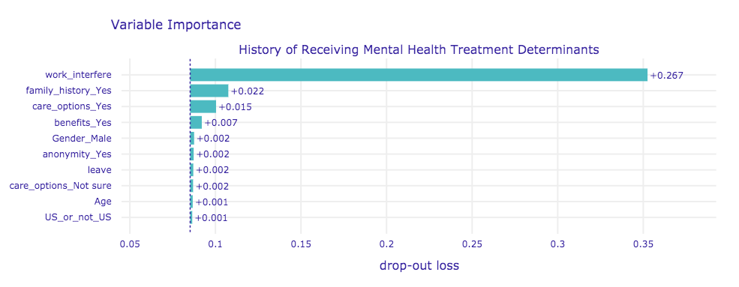
Appendix - Feature Importance

